Slide 1
Advancing Software Product Management Education:
Insights from an Industry Survey
North Carolina State University, USA
Hannah Estes, Katie Hollowell, John Cheek, Shiv Patel, Hanna Reese, Kathryn T. Stolee

Slide 2



To deliver a valuable product, SPMs must be liaisons between 3 primary stakeholders [Kittlaus and Fricker, 2017].
Software Product Managers
Customers
Software Engineers
Business
What’s Needed
What’s Possible
What’s Strategic

Slide 3
This research was inspired by the need for an undergrad SPM course at NC State.
1
2
At NC State, 1 in 24 computer science graduates become software product managers (or similar).
Only one ACM CS curriculum, CC2020 [1], mentions following product management procedures, but without guidance.
Notes:
Computing Curricula 2020: Paradigms for Global Computing Education → CC2020
Software Engineering 2014: Curriculum Guidelines for Undergraduate Degree Programs in Software Engineering → SE2014
Computer Science Curricula 2023 → CS2023
* Establish a timeline and emphasis the ”research was inspired by….”

Slide 4
We surveyed a variety of industry practitioners to understand
what SPMs wished they had learned to better prepare themselves.
Notes:
To better prepare them for the career path

Slide 5
We surveyed a variety of industry practitioners to understand
how SPMs are valuable to the software team.

Slide 6

RQ1: Education
Only for SPMs:
→ list up to 5 topics, skills, and abilities
→ describe why each is important
What topics, skills, or abilities do practicing software product managers think should be taught to future product managers enrolled in a computer science program?

Slide 7

RQ2: Value
For SPMs & SWEs:
→ describe the most valuable thing that the role provides to software teams
What value do software product managers add to a team, according to software engineers and software product managers?

Slide 8
Survey Summary
Response Collection
131 Responses
Demographics
Alumni Newsletters
Personal Networks
Snowball Sampling
59 SPMs
63 SWEs
9 Neither
Years of Experience
Education
Gender
Representing 24+ software companies!

Slide 9
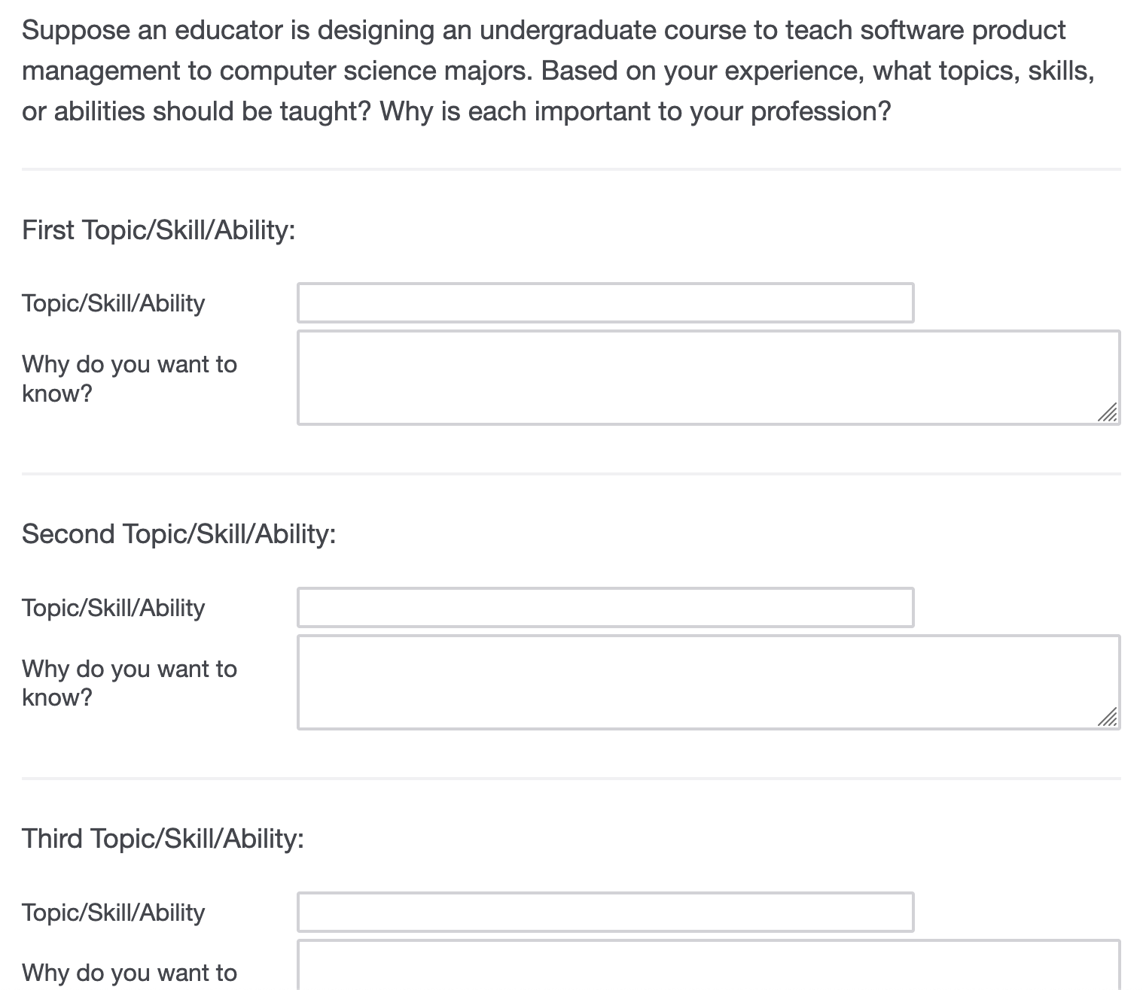
RQ1: Survey Design

Slide 10
RQ1: Open Card Sorting
Cards
(i.e., topics, skills, abilities)
Categories
(i.e., competencies)
Themes
Statistics
Statistics
Data Analysis
Data Analysis
Data Intelligence
Data Intelligence
CI/CD
CI/CD
System or Usability?
Technical Knowledge
Testing
Testing
Software Development Skills
Software Development Skills
Product Analytics
Product Analytics
Relevant Technical Jargon
Relevant Technical Jargon
Notes:
Add how we incorporated the “why”
Emphasize the why (mobile preview on Qualtrics)

Slide 11
RQ1: Open Card Sorting
Cards
(i.e., topics, skills, abilities)
Categories
(i.e., competencies)
Themes
Statistics
Statistics
Software Development Skills
Software Development Skills
Testing
Testing
CI/CD
CI/CD
116 cards
21 competencies
3 themes
Data Intelligence
Data Intelligence
Technical Knowledge
Data Analysis
Data Analysis
Product Analytics
Product Analytics
Relevant Technical Jargon
Relevant Technical Jargon
Notes:
Add how we incorporated the “why”

Slide 12
RQ1: Results
(rank, # cards)
Venus
3.1 Business Knowledge
3.2 Technical Knowledge
3.3 Soft Skills
(1st, 11)
(1st, 11)
(2nd, 10)
Understanding the Customer
Software Development Skills
Stakeholder Communication
(3rd, 9)
(3rd, 9)
Interpersonal Communication
Product Sense
Data Analysis
Writing
Market Research & Understanding
Design Thinking
Conflict Resolution
Data-Driven Decision Making
Domain-Specific Knowledge
Critical Thinking
Prioritization
Human-Computer Interaction
Empathy
Marketing & Go To Market
Software Development Methodologies
Leadership
Understanding the Problem
Time Management
Notes:
* Separate labels from paper

Slide 13
RQ1: SPM Education & Empirical Related Works
 | Ebert [2] | Maglyas et al. [7] | Rachitsky [9] | Sipos and Szabó [10] | Springer and Miler [11]
3.1.1 Understanding the Customer |  |  |  | X
3.1.2 Product Sense | X | X | X | X
3.1.3 Market Research & Understanding |  |  | X |  | X
3.1.4 Data-Driven Decision Making |  | X | X | X | X
3.1.5 Prioritization | X | X | X | X
3.1.6 Marketing & Go To Market |  | X |  | X | X
3.1.7 Understanding the Problem | X |  |  | X | X
3.2.1 Software Development Skills | X |  | X
3.2.2 Data Analysis |  |  |  | X | X
3.2.3 Design Thinking |  |  |  | X | X
3.2.4 Domain-Specific Knowledge
3.2.5 Human-Computer Interaction |  |  | X | X | X
3.2.6 Software Development Methodologies | X | X |  | X
3.3.1 Stakeholder Communication | X |  | X | X | X
3.3.2 Interpersonal Communication |  | X | X | X | X
3.3.3 Writing
3.3.4 Conflict Resolution |  | X |  | X
3.3.5 Critical Thinking |  |  | X | X | X
3.3.6 Empathy |  |  | X | X | X
3.3.7 Leadership | X | X |  | X | X
3.3.8 Time Management |  |  |  | X | X
RQ1 Competencies
SPM Education did not include hiring, but the SPMRF did.
Domain-specific knowledge did not appear elsewhere.
Writing was not explicitly mentioned in prior work.
Notes:
* Provide context for the 5 works that we chose

Slide 14
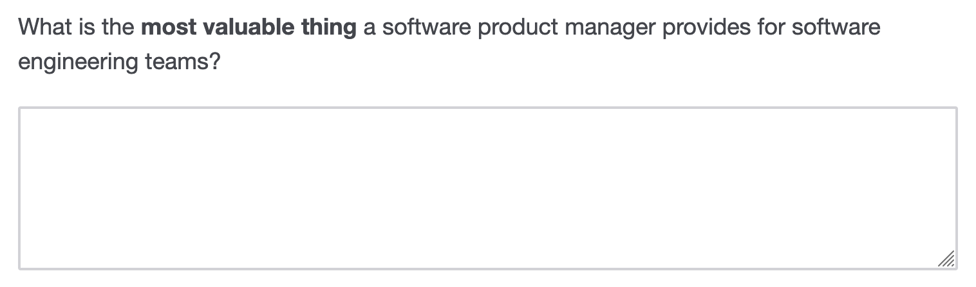
RQ2: Survey Design

Slide 15
RQ2: SPM Value Open Card Sorting
Cards
Categories
Themes
Communication with stakeholders when we are experiencing roadblocks.
SWE_{66a} :
Product gets to decide how resources are allocated on each epic of work so when we say we can’t hit a deadline because we have a dependency on another team, product gets that team to prioritize that work so we can be unblocked.”
SWE₆₆ :
SWE_{66b} :

Slide 16
RQ2: SPM Value Open Card Sorting
Cards
Categories
Themes
SWE_{66a} :
Communication with stakeholders when we are experiencing roadblocks.
Stakeholder Coordination
Communication
Product gets to decide how resources are allocated on each epic of work so when we say we can’t hit a deadline because we have a dependency on another team, product gets that team to prioritize that work so we can be unblocked.”
Product gets to decide how resources are allocated on each epic of work so when we say we can’t hit a deadline because we have a dependency on another team, product gets that team to prioritize that work so we can be unblocked.”
SWE_{66b} :
Priorities
Planning

Slide 17
RQ2: Open Card Sorting
Cards
Categories
Themes
85 cards
72 responses
10 categories
3 themes
Notes:
Add how we incorporated the “why”

Slide 18
RQ2 Results
 | Total |  | SWE |  | SPM
 | # | % | # | % | # | %
4.1 Planning | 43 | 51% | 17 | 49% | 26 | 52%
4.1.1 Direction | 23 | 27% | 9 | 26% | 14 | 28%
4.1.2 Priorities | 10 | 12% | 3 | 9% | 7 | 14%
4.1.3 Vision | 10 | 12% | 5 | 14% | 5 | 10%
4.2 Context | 23 | 27% | 6 | 17% | 17 | 34%
4.2.1 The Grand Scheme of Things | 8 | 9% | 2 | 6% | 6 | 12%
4.2.2 Business & Market Context | 5 | 6% | 1 | 3% | 4 | 8%
4.2.3 Customer Context | 5 | 6% | 1 | 3% | 4 | 8%
4.2.4 Developer Context | 5 | 6% | 2 | 6% | 3 | 6%
4.3 Communication | 19 | 22% | 12 | 34% | 7 | 14%
4.3.1 PM ⬄ Team | 9 | 11% | 4 | 11% | 5 | 10%
4.3.2 Stakeholder Coordination | 7 | 8% | 5 | 14% | 2 | 4%
4.3.3 When NOT to Talk | 3 | 4% | 3 | 9% | 0 | 0%
Total | 85 | 100% | 35 | 100% | 50 | 100%

Slide 19
Immediate Impact for the Undergraduate CS SPM Course
Notes:
Wasn’t clear that this is the class that was established earlier

Slide 20
I put [product management] to use by dogfooding the product within my team once I had a working prototype…it highlighted gaps in documentation and painted a fuller picture of how the product would be used.
“”
Alum of the 1st SPM Class
Notes:
Explain what dogfooding is
What is the significance of this
Taught SPM skills and providing value to an alumni

Slide 21
5) Use metrics to evaluate improvements to a software product
Original SPM SLOs + 21 Competencies
[NEW] Examine the competitive landscape to differentiate product
[NEW] Examine the competitive landscape to differentiate product
1) Identify unmet customer needs for a software product
5) Use metrics to evaluate improvements to a software product
4) Examine and explain the business value for a software product
3) Create a plan for mitigating risk during a software project
2) Create a feasible schedule for a team of software developers to improve the product to meet the customer needs
1) Identify unmet customer needs for a software product
(3 cross-cuts)
Venus
3.1 Business Knowledge
3.2 Technical Knowledge
3.3 Soft Skills
(1)
Understanding the Customer
Software Development Skills
Stakeholder Communication
(4)
(5)
Interpersonal Communication
Product Sense
Data Analysis
(6)
Design Thinking
Writing
Market Research & Understanding
Conflict Resolution
(5)
Domain-Specific Knowledge
Data-Driven Decision Making
Critical Thinking
(2)
Human-Computer Interaction
Prioritization
Empathy
(6)
Software Development Methodologies
Marketing & Go To Market
Leadership
(1)
Time Management
Understanding the Problem

Slide 22
5) Use metrics to evaluate improvements to a software product
What is missing?
[NEW] Examine the competitive landscape to differentiate product
[NEW] Examine the competitive landscape to differentiate product
5) Use metrics to evaluate improvements to a software product
4) Examine and explain the business value for a software product
3) Create a plan for mitigating risk during a software project
2) Create a feasible schedule for a team of software developers to improve the product to meet the customer needs
1) Identify unmet customer needs for a software product
Focus
(3 cross-cuts)
Venus
3.1 Business Knowledge
3.2 Technical Knowledge
3.3 Soft Skills
(1)
Understanding the Customer
Software Development Skills
Stakeholder Communication
(4)
(5)
Interpersonal Communication
Product Sense
Data Analysis
(6)
Design Thinking
Writing
Market Research & Understanding
Conflict Resolution
(5)
Domain-Specific Knowledge
Data-Driven Decision Making
Critical Thinking
(2)
Human-Computer Interaction
Prioritization
Empathy
(6)
Software Development Methodologies
Marketing & Go To Market
Leadership
(1)
Time Management
Understanding the Problem

Slide 23


Original Course Structure
(almost) Every Class
Lenny’s Podcast
Group Project
Enhancing Software Product
Listen to and discuss an episode
Topics on roadmapping and strategy to personal development and presenting
Identify problems through public forums
Identify opportunities and solutions
Present findings
Notes:
WHAT COULD BE

Slide 24
[New] Course Structure
(almost) Every Class
Lenny’s SPM Podcast
Group Project
Enhancing Software Product
surveys and interviews.
public forums.
Listen to and discuss an episode
Topics from roadmapping and strategy to personal development and presenting
Identify problems through public forums
2. Identify opportunities and solutions.
3. Situate findings compared to their competitors.
4. Present findings
using data (i.e., direct quotes,
metrics, risks, and mitigations) to support their decisions.
Notes:
WHAT COULD BE
Relate to the research!
1. surveys & interviews -> relates to soft skills
3. new SLO
4. data driven and other slos

Slide 25
What’s Next?
Developer-focused research highlights their…
Daily Life
Productivity
their typical activities
what a good day looks like
perceived vs. actual
how to improve it
André N. Meyer, Earl T. Barr, Christian Bird, and Thomas Zimmermann. 2019. Today was a good day: The daily life of software developers. IEEE Trans. Softw. Eng. 47, 5 (2019), 863–880.
Emerson Murphy-Hill, Ciera Jaspan, Caitlin Sadowski, David Shepherd, Michael Phillips, Collin Winter, Andrea Knight, Edward Smith, and Matthew Jorde. 2019. What predicts software developers’ productivity? IEEE Trans. Softw. Eng. 47, 3 (2019), 582–594.
Saulius Astromskis, Gabriele Bavota, Andrea Janes, Barbara Russo, and Massimiliano Di Penta. 2017. Patterns of developers behaviour: A 1000-hour industrial study. J. Syst. Softw. 132 (2017), 85–97.
C. Jaspan and C. Green, "A Human-Centered Approach to Developer Productivity," in IEEE Software, vol. 40, no. 1, pp. 23-28, Jan.-Feb. 2023.
André N. Meyer, Laura E. Barton, Gail C. Murphy, Thomas Zimmermann, and Thomas Fritz. 2017. The Work Life of Developers: Activities, Switches and Perceived Productivity. IEEE Trans. Softw. Eng. 43, 12 (2017), 1178–1193.

Slide 26
What’s Next?
An SPM’s
Day in the Life
Quantifying How They Spend Their Time

Slide 27
Advancing Software Product
Management Education:
Insights from an Industry Survey
Hannah Estes
Survey of 122 industry practitioners — 59 SPMs and 63 SWEs — from 24+ companies
SPM curricula should include 21 competencies: technical knowledge, business knowledge, and soft skills.
SPMs provide value to software teams through planning, providing context, and effective communication.
hmestes@ncsu.edu
hannahestes.github.io
Kathryn T. Stolee
ktstolee@ncsu.edu
kstolee.github.io
CREDITS: This presentation template was created by Slidesgo, and includes icons by Flaticon.

Slide 28
Extra Slides

Slide 29
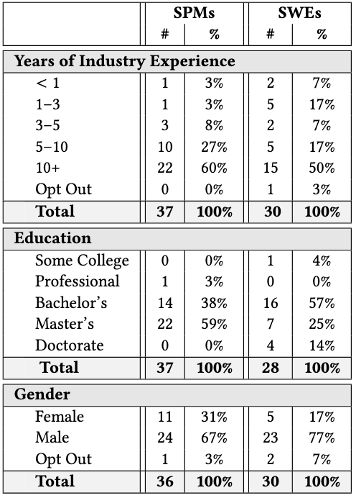
Demographic Data
AWS
Amazon
Anthropic
Bandwidth
Bank of America
Buildertrend
CommerceHub
DaVinci Education Inc
Digital Turbine
DigitalOcean
Endor Labs
Fortinet
Google
IBM
LexisNexis
Meta
Microsoft
Oracle
Pendo
Procter & Gamble
Prometheus Group
Redfin
Rithum
SAS Institute
Vistaly

Slide 30
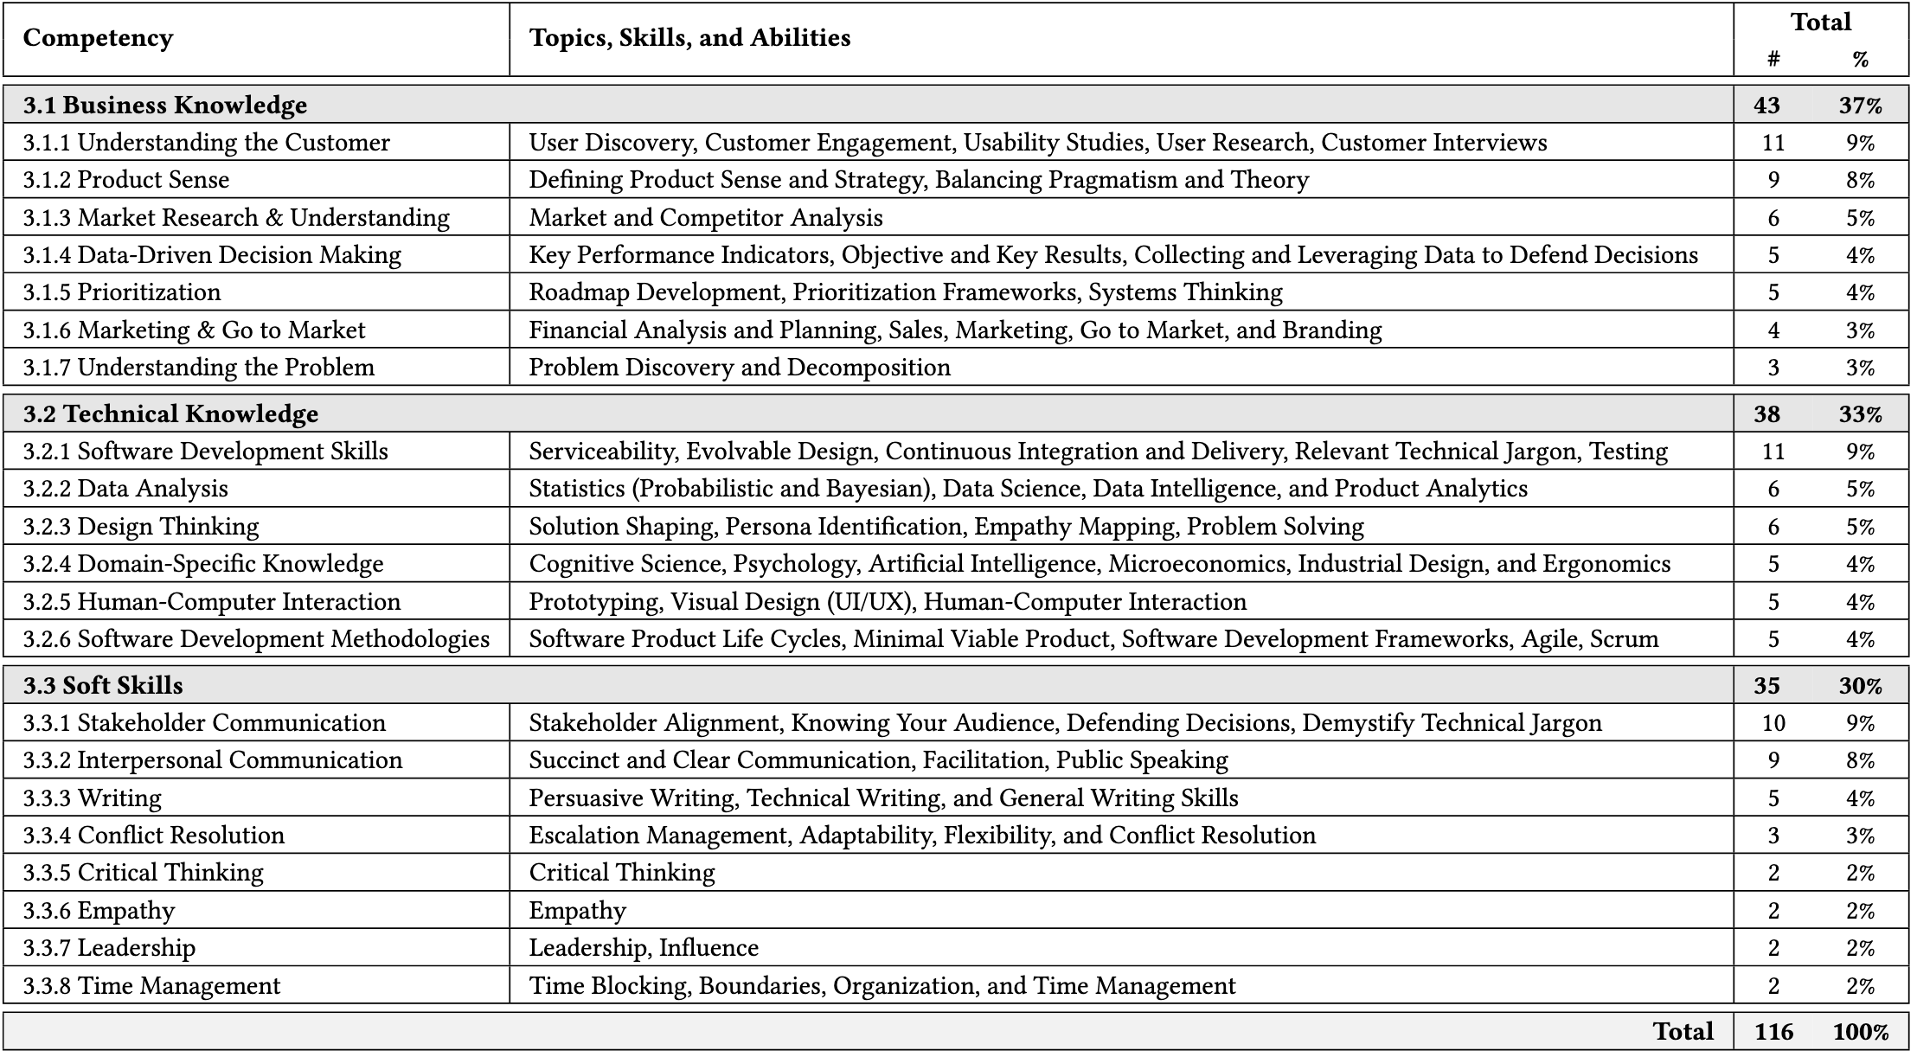

Slide 31
Immediate Impact: SLOs for SPM class
1
Identify unmet customer needs for a software product
2
Create a feasible schedule for a team of software developers to improve the product to meet the customer needs
3
Create a plan for mitigating risk during a software project
4
Examine and explain the business value for a software product
NEW
5
Examine the competitive landscape to differentiate product

Slide 32
References
[1] CC2020 Task Force. 2020. Computing Curricula 2020: Paradigms for Global Computing Education. Association for Computing Machinery, New York, NY, USA.
[2] Christof Ebert. 2007. The impacts of software product management. J. Syst. Softw. 80, 6 (June 2007), 850–861. https://doi.org/10.1016/j.jss.2006.09.017
[3] Hannah Estes and Kathryn T. Stolee. Advancing Software Product Management Education: Insights from an Industry | Survey Materials. https://doi.org/10.5281/zenodo.15212362
[4] Joint Task Force on Computing Curricula. 2015. 2. Association for Computing Machinery, New York, NY, USA. https://www.acm.org/binaries/content/assets/education/se2014.pdf
[5] Hans-Bernd Kittlaus and Samuel A. Fricker. 2017. Software product management. Springer-Verlag GmbH Germany, Berlin.
[6] Amruth N. Kumar, Rajendra K. Raj, Sherif G. Aly, Monica D. Anderson, Brett A. Becker, Richard L. Blumenthal, Eric Eaton, Susan L. Epstein, Michael Goldweber, Pankaj Jalote, Douglas Lea, Michael Oudshoorn, Marcelo Pias, Susan Reiser, Christian Servin, Rahul Simha, Titus Winters, and Qiao Xiang. 2024. Computer Science Curricula 2023. Association for Computing Machinery, New York, NY, USA.
[7] Andrey Maglyas, Uolevi Nikula, and Kari Smolander. 2013. What are the roles of software product managers? An empirical investigation. J. Syst. Softw. 86, 12 (Dec. 2013), 3071–3090. https://doi.org/10.1016/j.jss.2013.07.045
[8] Charlie Parker, Sam Scott, and Alistair Geddes. 2019. Snowball sampling. SAGE Research Methods Foundations. Sage.
[9] Lenny Rachitsky. 2020. Product Management Survey. https://www.lennysnewsletter.com/p/product-management-survey
[10] Andrea Sipos and Bálint Szabó. 2024. Exploring the expectations of the product manager role: the case of the Hungarian software industry. Vezetéstudomány-Budapest Management Review 55, 7-8 (2024), 18–31.
[11] Olga Springer and Jakub Miler. 2018. The Role of a Software Product Manager in Various Business Environments. In 2018 Federated Conference on Computer Science and Information Systems (FedCSIS), 985–994.
[12] T. Zimmermann. 2016. Card-sorting. Perspectives on Data Science for Software Engineering (2016), 137–141. https://doi.org/10.1016/b978-0-12-804206-9.00027-1

